Slide 1
Lecture 05 Dynamic programming II
Spring 2024
Zhihua Jiang

Slide 2
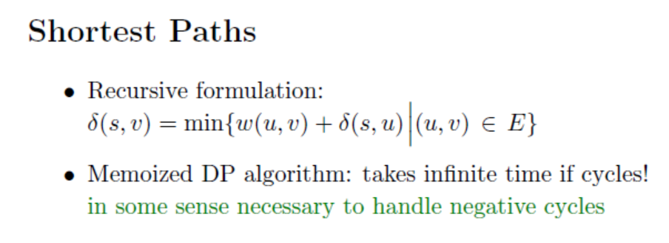
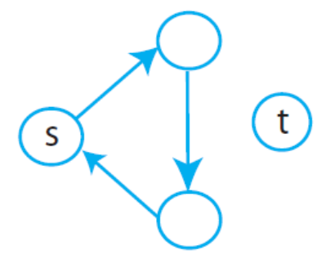

Slide 3
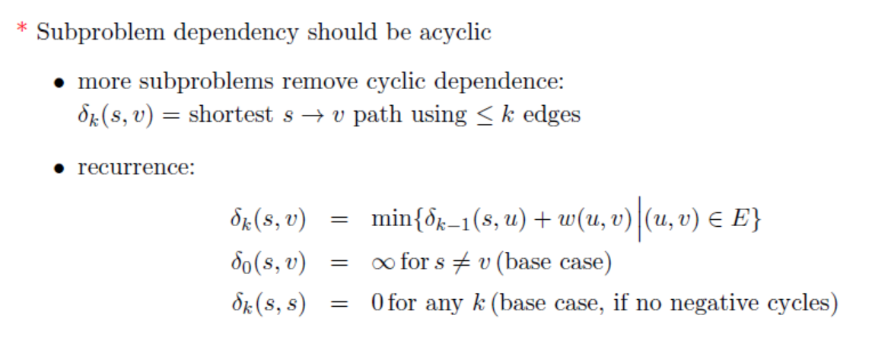
K作为一个限制，最短路径内花费最多k个edges
K-1的数学意义：用掉了一次edge

Slide 4
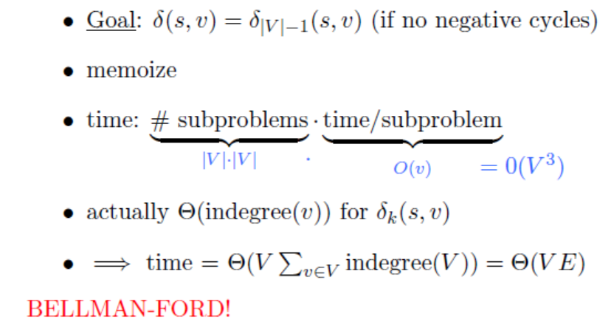

|v|-1 = k的最大取值

Slide 5
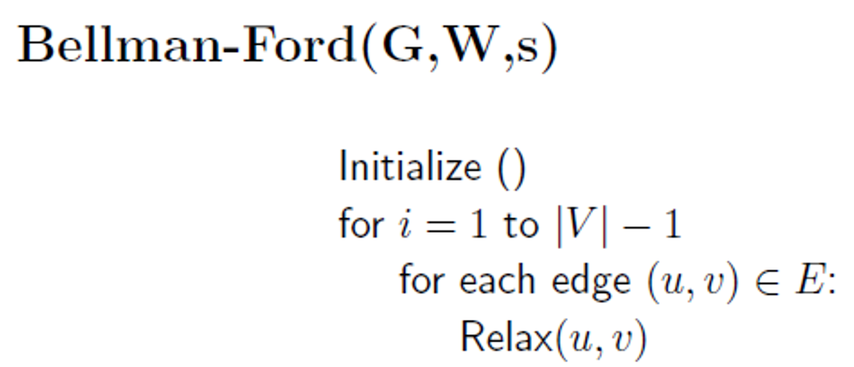
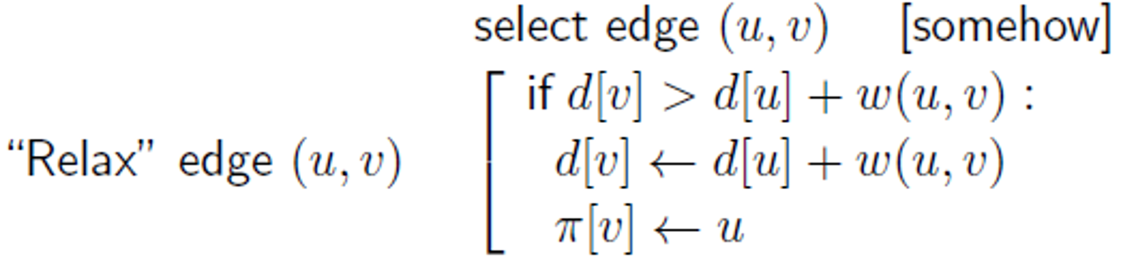





Slide 6
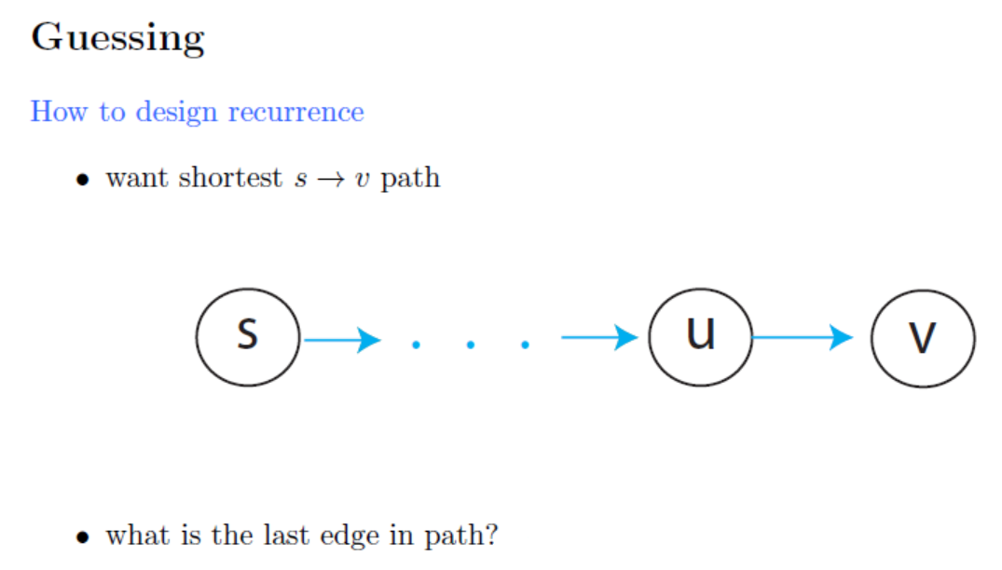


Slide 7
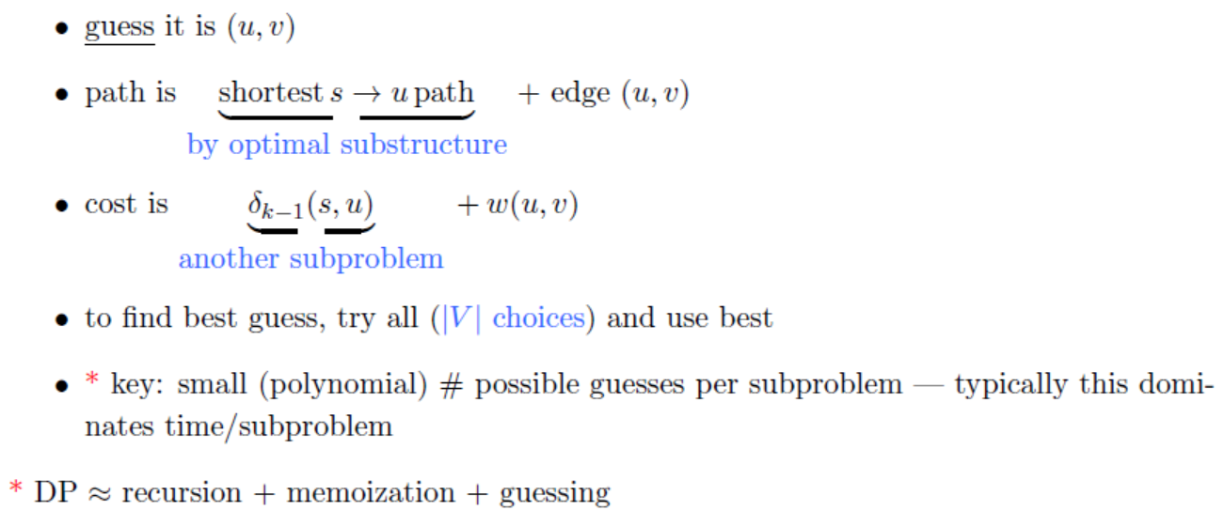

Slide 8
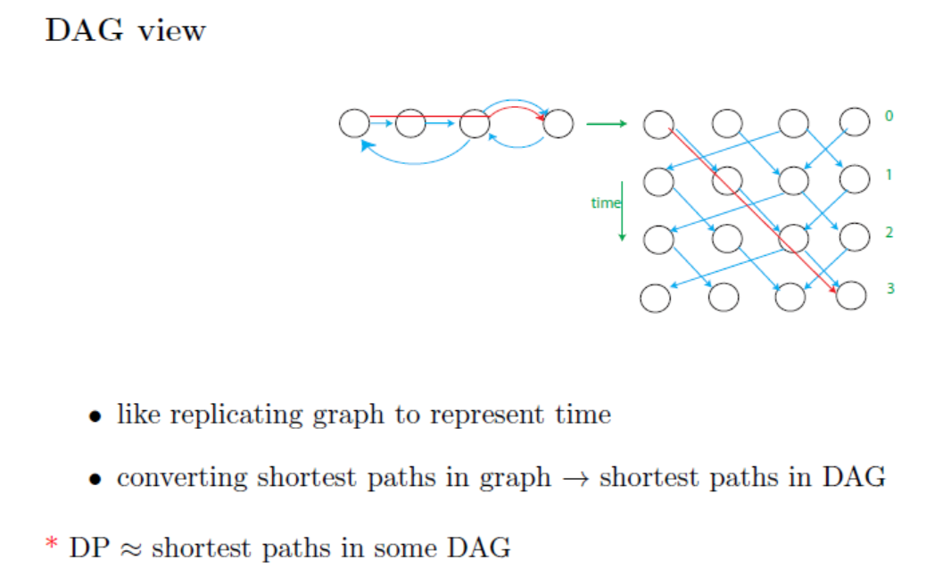

Slide 9
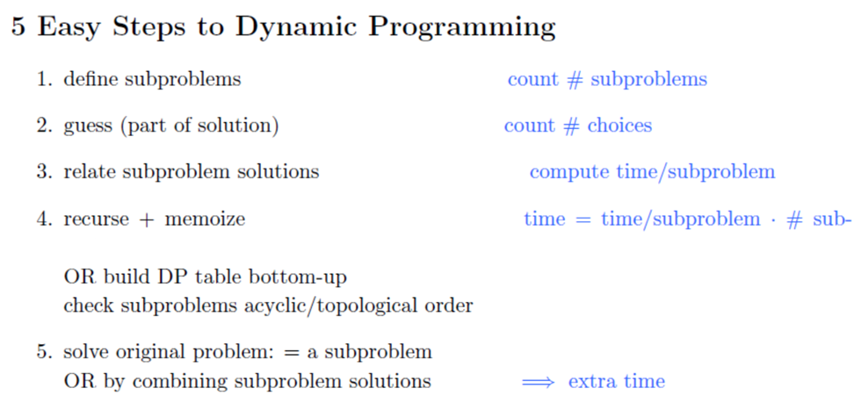

Slide 10
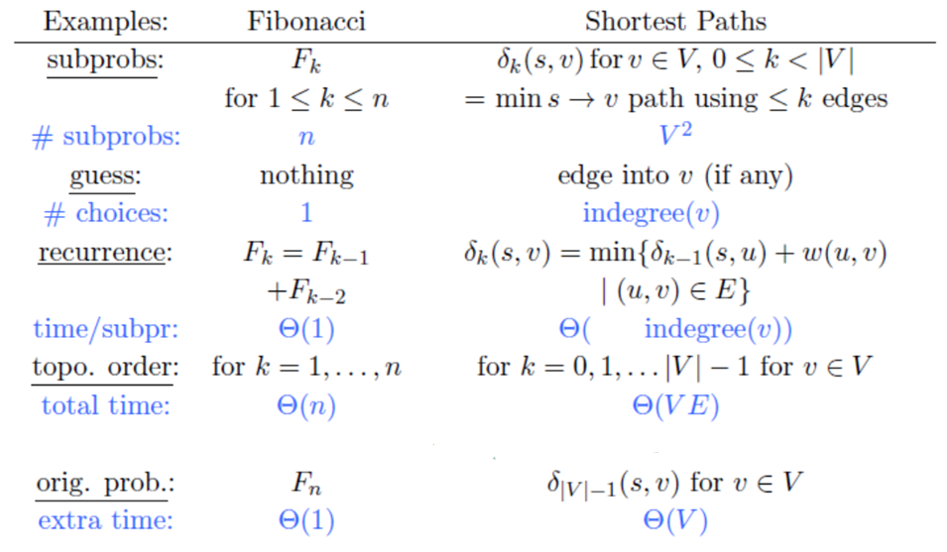

Slide 11
Exercise 1
Notes:
palindromic
英 [ˌpælɪn'drɒmɪk]
symmetric

Slide 12
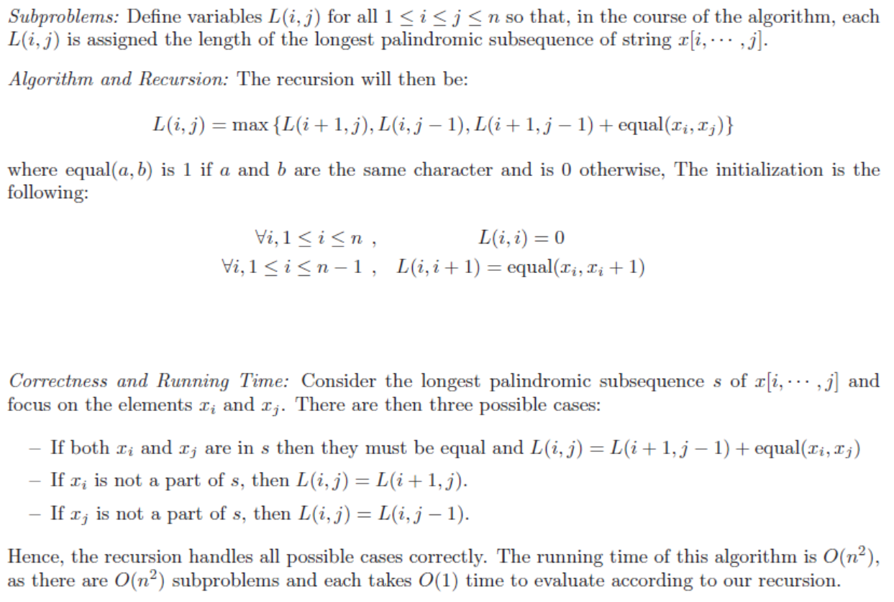
x_{i+1}
For s=1 to n-1
for i=1 to n-s
j=i+s
Notes:
palindromic
英 [ˌpælɪn'drɒmɪk]

Slide 13
i
 | A | C | G | T | G | T | C | A | A | A | A | T | C | G
A | 0
C | 0 | 0
G | 0 | 0 | 0 |  |  |  | (i, j-1) | (i+1, j-1)
T | 0 | 0 | 0 | 0 |  |  | (i,j) | (i+1, j)
G | 1 | 1 | 1 | 0 | 0
T |  | 1 | 1 | 1 | 0 | 0
C |  |  | 1 | 1 | 0 | 0 | 0
A |  |  |  | 1 | 0 | 0 | 0 | 0
A |  |  |  |  | 1 | 1 | 1 | 1 | 0
A |  |  |  |  |  | 1 | 1 | 1 | 1 | 0
A |  |  |  |  |  |  | 2 | 2 | 1 | 1 | 0
T |  |  |  |  |  |  |  | 2 | 1 | 1 | 0 | 0
C |  |  |  |  |  |  |  |  | 1 | 1 | 0 | 0 | 0
G |  |  |  |  |  |  |  |  |  | 1 | 0 | 0 | 0 | 0
j

Slide 14
I
 | A | C | G | T | G | T | C | A | A | A | A | T | C | G
A | 0
C | 0 | 0
G | 0 | 0 | 0
T | 0 | 0 | 0 | 0
G | 1 | 1 | 1 | 0 | 0
T | 1 | 1 | 1 | 1 | 0 | 0
C | 2 | 2 | 1 | 1 | 0 | 0 | 0
A | 3 | 2 | 1 | 1 | 0 | 0 | 0 | 0
A | 3 | 2 | 1 | 1 | 1 | 1 | 1 | 1 | 0
A | 3 | 2 | 1 | 1 | 1 | 1 | 1 | 1 | 1 | 0
A | 3 | 2 | 2 | 2 | 2 | 2 | 2 | 2 | 1 | 1 | 0
T | 3 | 3 | 3 | 3 | 3 | 3 | 2 | 2 | 1 | 1 | 0 | 0
C | 4 | 4 | 3 | 3 | 3 | 3 | 3 | 2 | 1 | 1 | 0 | 0 | 0
G | 4 | 4 | 4 | 4 | 4 | 3 | 3 | 2 | 1 | 1 | 0 | 0 | 0 | 0
J

Slide 15
Exercise 2
V(G)=0
V(D)=0
V(F)=min{1,1+0}=1
V(E)=min{2+0,1+1}=2
V(C)=0
V(A)=min{1+1,1+2}=2
V(B)=min{2+2,1+2}=3
Best cover: {B, E, G} or {B, E, F}

Slide 17
Exercise 3

Slide 19
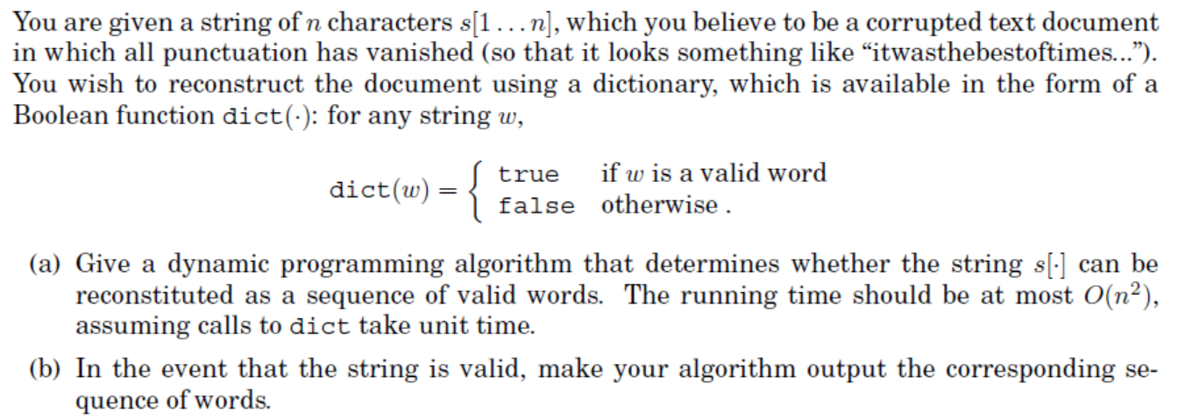
Exercise 4

Slide 20
